Slide 1
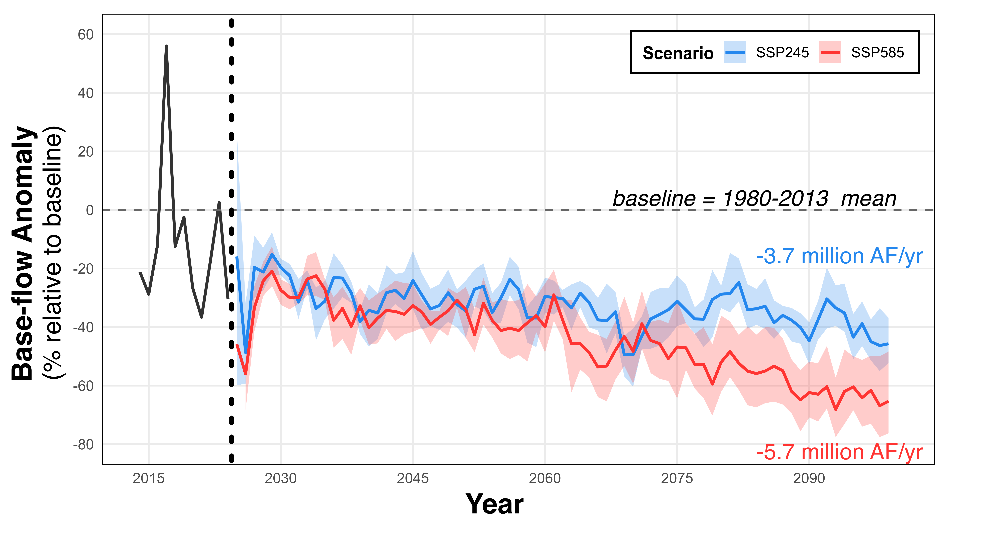
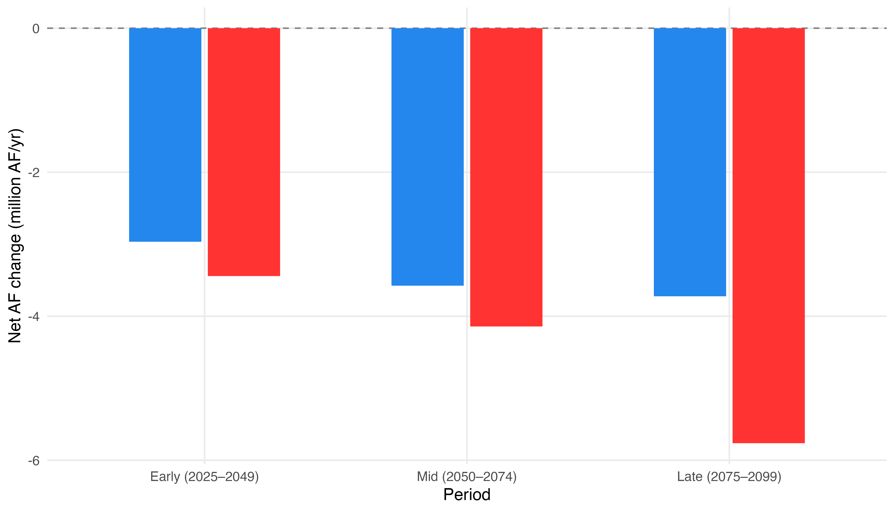
a
b

Slide 2
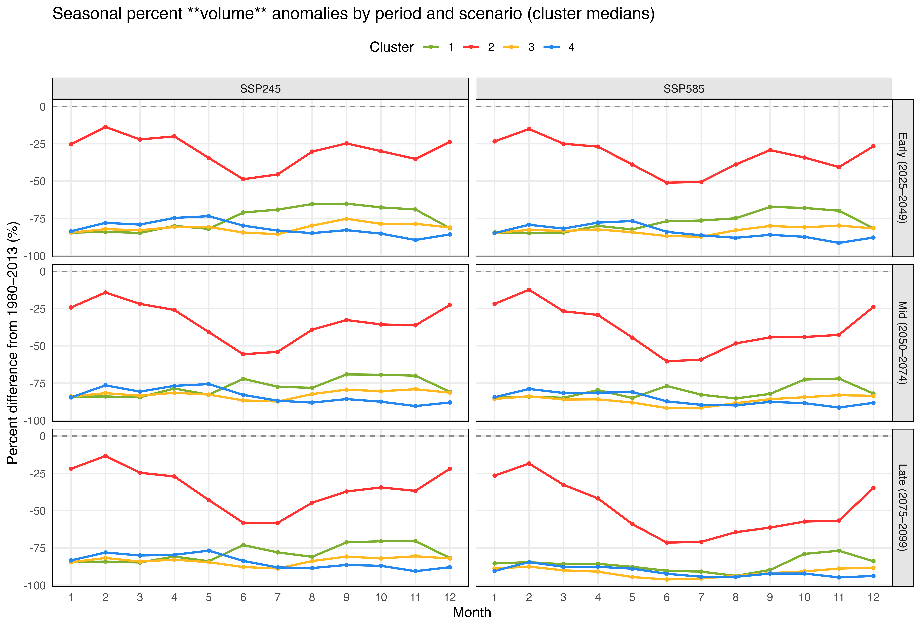
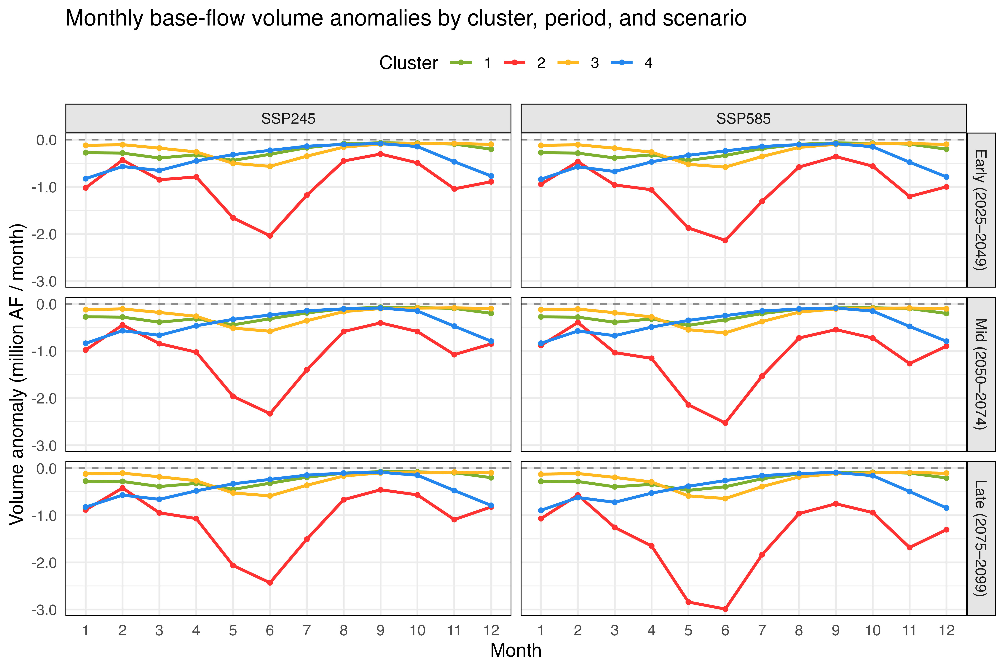
a
b

Slide 3
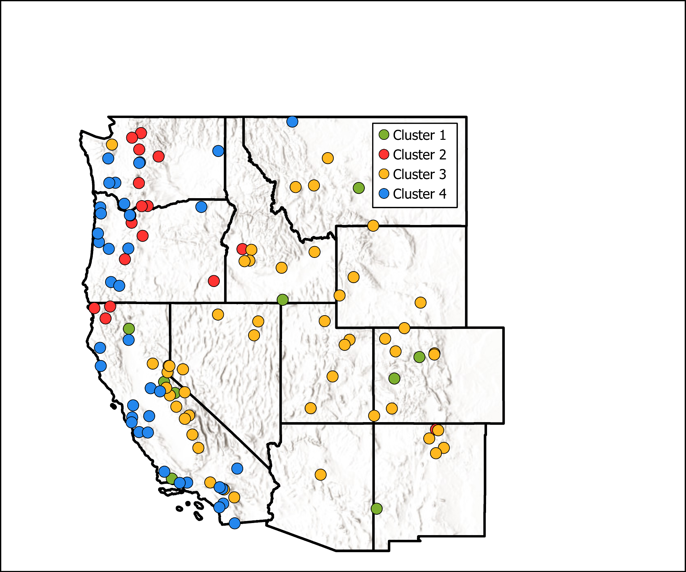
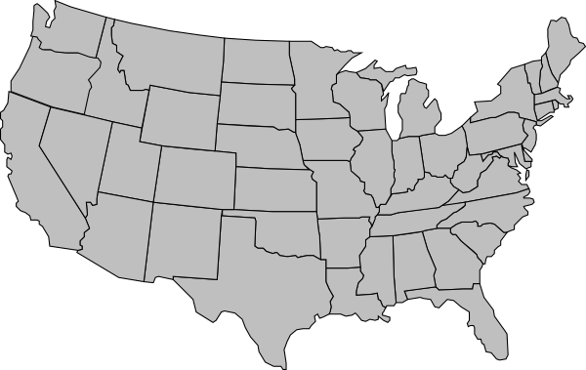
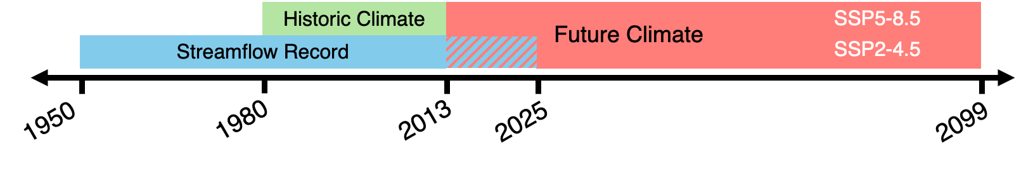
a
b
Historic Climate
SSP5-8.5
Future Climate
Streamflow Record
SSP2-4.5
1950
1980
2013
2025
2099

Slide 4

a
Recurrent Neural Network
Memory
Input Layer
LSTM Layer
Dense Layer
Output Layer
Input
Output
b
x₁
x₂
x₃
.
.
.
x_{n}
24-month Climate
Time Series
x_{n}
ŷ₁
Next Month
Base Flow
Input Data
.
.
.
.
.
.
.
.
.
Output
x₁
.
.
.
x_{m}
Static Basin
Attributes
= dropout
Input Layer
LSTM Layer
Dense Layer
Output Layer

Slide 5
Recurrent Neural Network
Memory
Input Layer
LSTM Layer
Dense Layer
Output Layer
Input
Output
Input Layer
LSTM Layer
Dense Layer
Output Layer
x₁
x₂
x₃
.
.
.
x_{n}
y₁
Climate Time-series
Sequence
y₂
x_{n}
Input Data
.
.
.
.
.
.
.
.
.
.
.
.
x₁
.
.
.
x_{n}
Static Basin
Attributes
y_{n}

Slide 6
Recurrent Neural Network
Memory
Input Layer
LSTM Layer
Dense Layer
Output Layer
Input
Output
Input Layer
LSTM Layer
Dense Layer
Output Layer
x₁
x₂
x₃
.
.
.
x_{n}
ŷ₁
Climate Time-series
Sequence
ŷ₂
x_{n}
Output
Input Data
.
.
.
.
.
.
.
.
.
.
.
.
x₁
.
.
.
x_{n}
Static Basin
Attributes
ŷ_{n}
X = dropout

Slide 7
Recurrent Neural Network
Memory
Input Layer
LSTM Layer
Dense Layer
Output Layer
Input
Output
Input Layer
LSTM Layer
Dense Layer
Output Layer
x₁
x₂
x₃
.
.
.
x_{n}
ŷ₁
Climate Time-series
Sequence
ŷ₂
x_{n}
Output
Input Data
.
.
.
.
.
.
.
.
.
.
.
.
x₁
.
.
.
x_{n}
Static Basin
Attributes
ŷ_{n}
X = dropout

